Slide 1
Capstone Project
Taxi trip time Prediction
Ankush

Slide 2
DISCUSSION POINTS
Data summary
Explore data summary
Eda
Create Model
Linear regression
Decision tree
Random Forest
Conclusion

Slide 3
Data Summary
id - a unique identifier for each trip.
vendor_id - a code indicating the provider associated with the trip record.
pickup_datetime - date and time when the meter was engaged.
dropoff_datetime - date and time when the meter was disengaged.
passenger_count - the number of passengers in the vehicle (driver entered value).
pickup_longitude - the longitude where the meter was engaged.
pickup_latitude - the latitude where the meter was engaged.

Slide 4
Data Summary
dropoff_longitude - the longitude where the meter was disengaged.
dropoff_latitude - the latitude where the meter was disengaged.
store_and_fwd_flag - This flag indicates whether the trip record was held in vehicle memory before sending to the vendor because the vehicle did not have a connection to the server - Y=store and forward; N=not a store and forward trip.
trip_duration - duration of the trip in seconds.
We have around 1.5 billion rows and 11 columns.

Slide 5
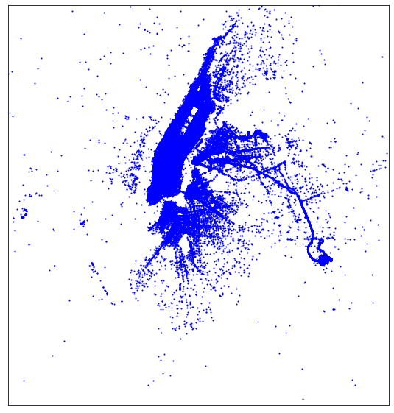
Pickup Location
We can see that most of the taxi pickups were done in the manhattan area as compared to the other areas in NYC.

Slide 6
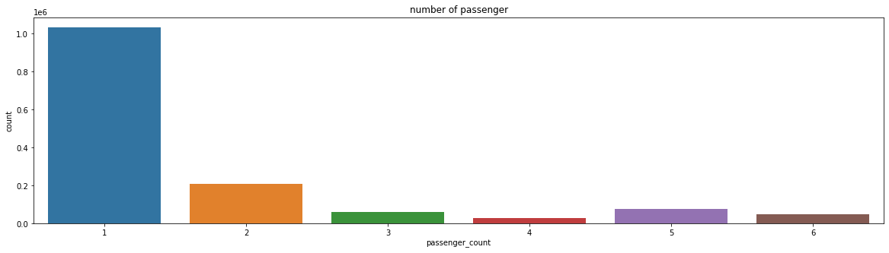
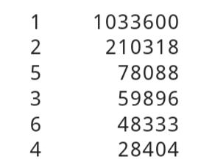
Passengers Count
Most of the trips consists only 1 passenger.

Slide 7
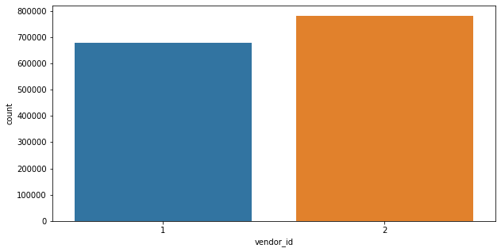
Vendor Id
Vendor 2 is evidently more famous among the population.

Slide 8
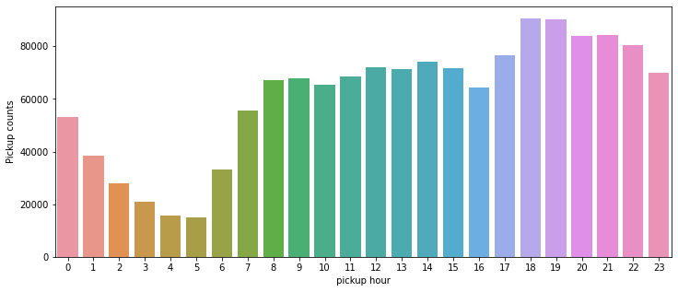
Pickup Time (Hours)
Most of pickups at between 5 PM to 10 PM. (Rush hour time )

Slide 9
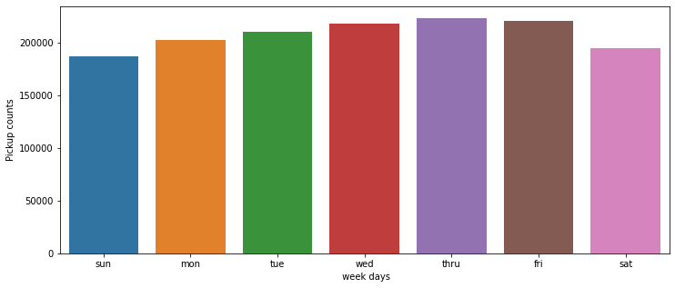
Pickup Weekday
Here we can see that Fridays are those days in a week when peoples generally prefer to rome in the city.

Slide 10
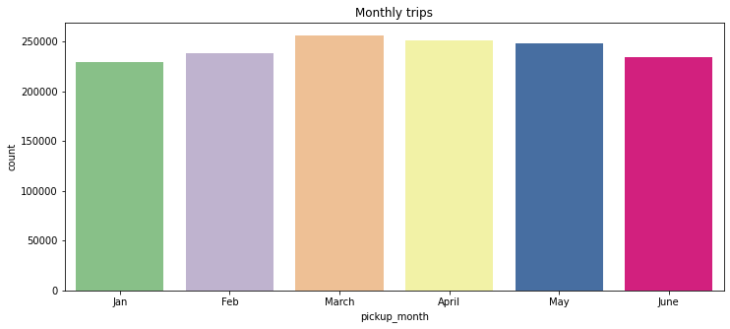
Months
Number of trips in a particular month - March and April marking the highest.
Trips in january and february are less may be due to snowfall in NYC.

Slide 11
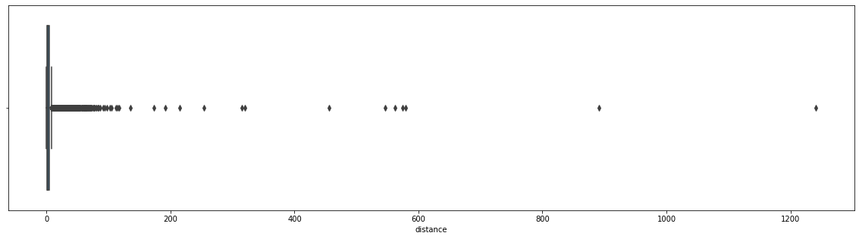
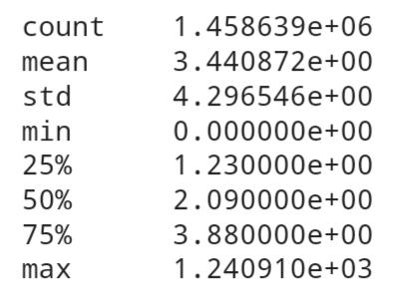
Distance
Average distance travelled is approx 3.5 kms.
There are also some trips over 1200 kms.

Slide 12
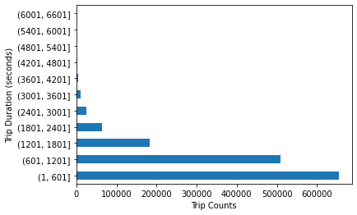
Trip Duration
Here we observe that most of the rides are of 10 minutes.

Slide 13
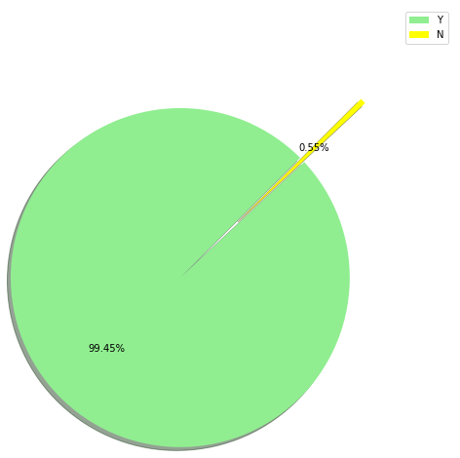
Store and fwd flag
There were very few trips (0.55%) of which the records were not stored in memory.

Slide 14
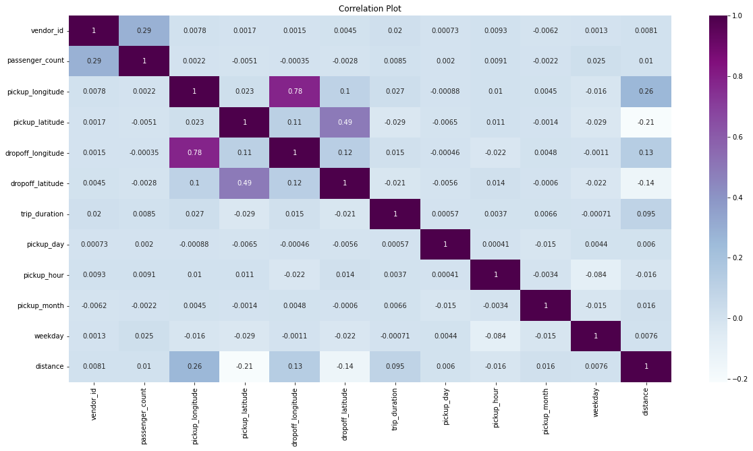
Heat map

Slide 15
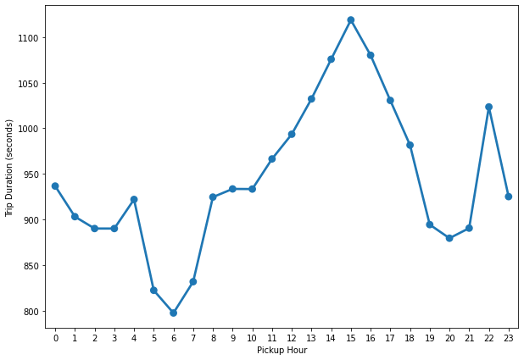
Trip duration per Hours
Average trip duration is lowest at 6 AM when the traffic is minimum.
Average trip duration is generally highest around 3 PM during the busy streets.

Slide 16
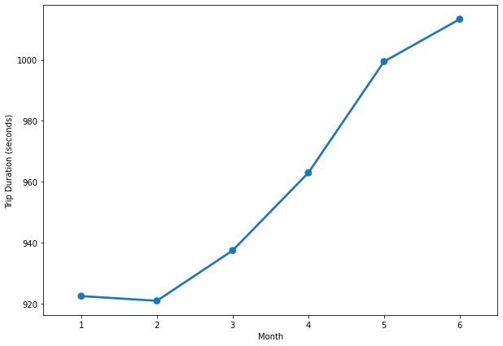
Trip duration per month
It is lowest during february when winters starts declining.
We can see an increasing trend in the average trip duration along with each subsequent month.

Slide 17
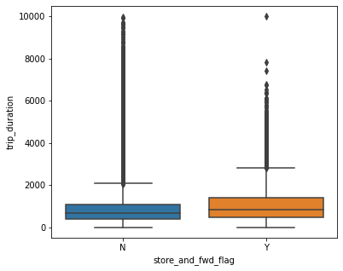
Trip Duration per Vendor
Interquartile range of trip duration is more for the trips with the flag 'Y' as compared to the trips with flag 'N'.
The median value is almost equal for both.

Slide 18
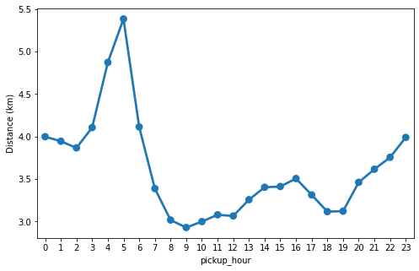
Distance per Hours
Trip distance is highest during early morning hours.
Possible reason behind this is Outstation trips taken during the weekends.
Trip distance is fairly equal from morning till the evening.

Slide 19
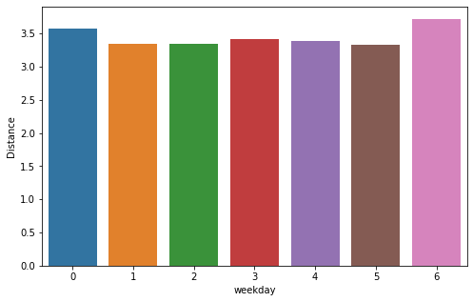
Distance per weekday
Sunday being at the top among these. May be the reason behind this is outstation trips or night trips or something like that.

Slide 20
Creating Model
We create model of :
Linear Regression - Model training and prediction are fast.
Decision Tree - Decision trees are very intuitive and easy to explain.
Random Forest - Random forests overcome several problems with decision trees like Reduction in overfitting.

Slide 21
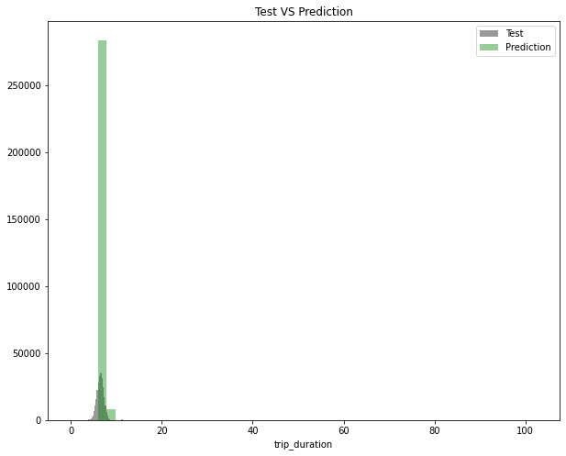
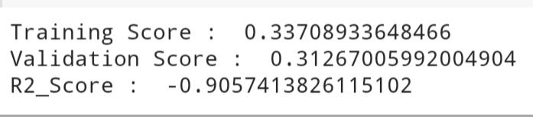
Linear Regression Model
This model is not working well.

Slide 22
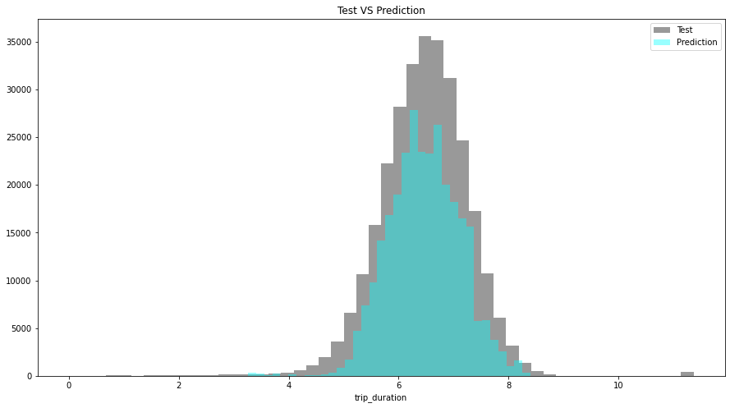
Decision Tree

Slide 23
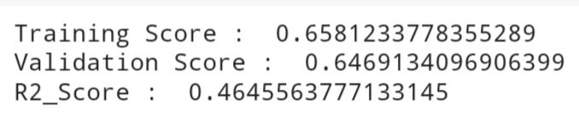
This model is working very well compare to linear regression.

Slide 24
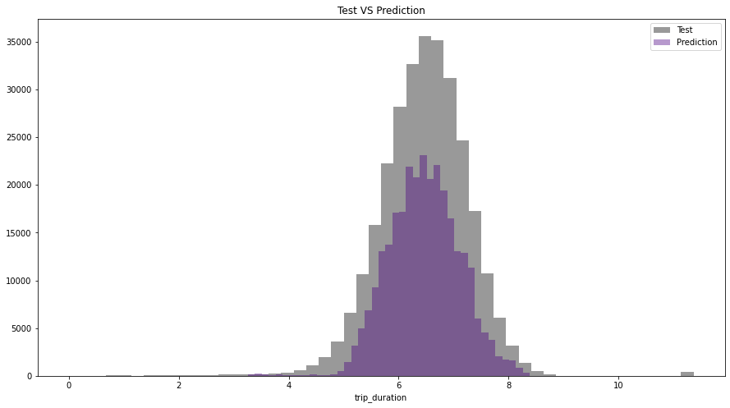
Random Forest

Slide 25
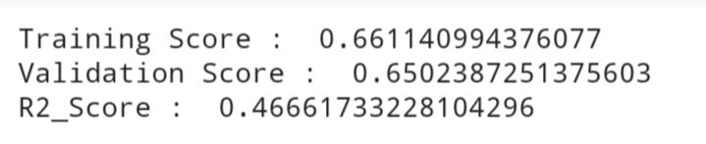
If we compare this with linear regression, then it also perform very well.
Linear Regression
Random Forest

Slide 26
Overall Conclusion
Most of the trip consists of 1 or 2 passengers.
Vendor 2 is evidently more famous among the population.
Most pickups are between 5 PM to 9 PM.
Fridays and Saturdays are those days in a week when people prefer to roam in the city.
Average distance traveled is approx 3.5 kms.
Most of the trips are limited to the range of 1-10 kms.
Most of the rides are 10 min.
There were very few trips (0.55%) of which the records were stored in memory.
Average trip duration is lowest at 6 AM when there is minimal traffic on the roads.

Slide 27
Overall conclusion
Most of the taxi pickups were done in the manhattan area as compared to the other areas in NYC.
Trip distance is highest during early morning hours.
Possible reason behind this is Outstation trips taken during the weekends.
Trip distance is fairly equal from morning till the evening
Sunday being at the top may be due to outstation trips or night trips.

Slide 28
Thank you

